Slide 1
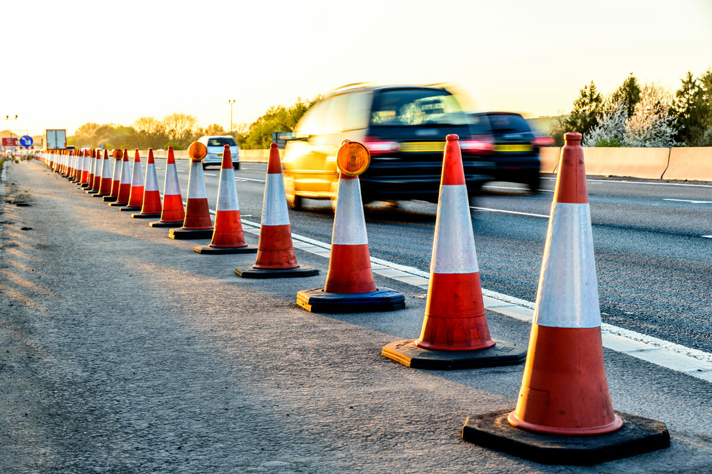
BANGALORE TRAFFIC PULSE
Muhammed shahil
Data Analytics

Slide 2
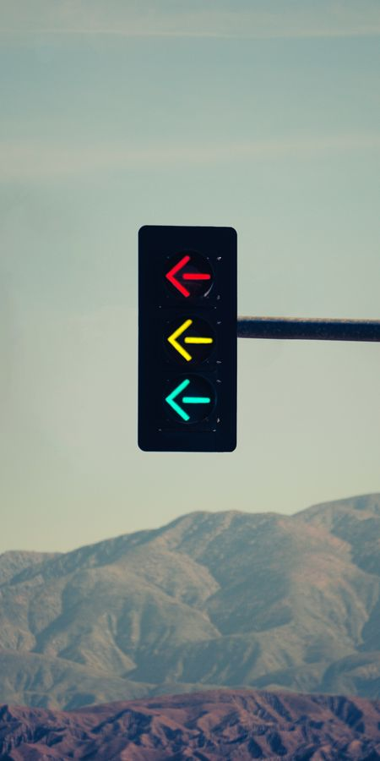
INTRODUCTION
This dataset captures various dimensions of traffic conditions in Bangalore, including congestion levels, travel times, road utilization, and public transportation statistics. By analyzing these metrics across different dates and areas, the data enables a thorough understanding of Bangalore’s traffic dynamics and potential factors influencing congestion, including environmental conditions and construction activities.

Slide 3
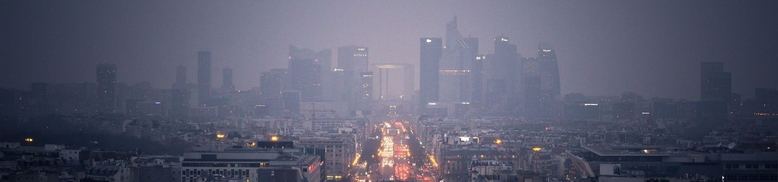
FEATURES
AREA NAME
ROAD INTERSECTION NAME
AVERAGE SPEED
TRAVEL TIME INDEX
CONGESTIONAL LEVEL
ROAD CAPACITY UTILIZATION
INCIDENT REPORT
ENVIRONMENTAL IMPACT
PUBLIC TRANSPORT USAGE
TRAFFIC SIGNAL COMPLIANCE
PARKING USAGE
PEDESTRIANAND CYCLIST COUNT
WEATHER CONDITIONS
ROAD WORK AND
CONSTRUCTION ACTIVITYT

Slide 4
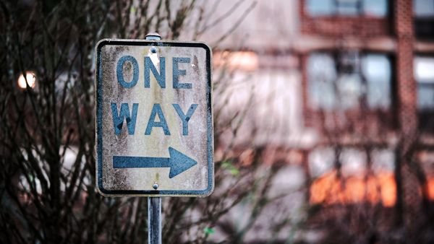
TARGET VALUE
The target value is "traffic volume“, which represents the number of vehicles or the intensity of traffic flow at a given time and location.

Slide 5
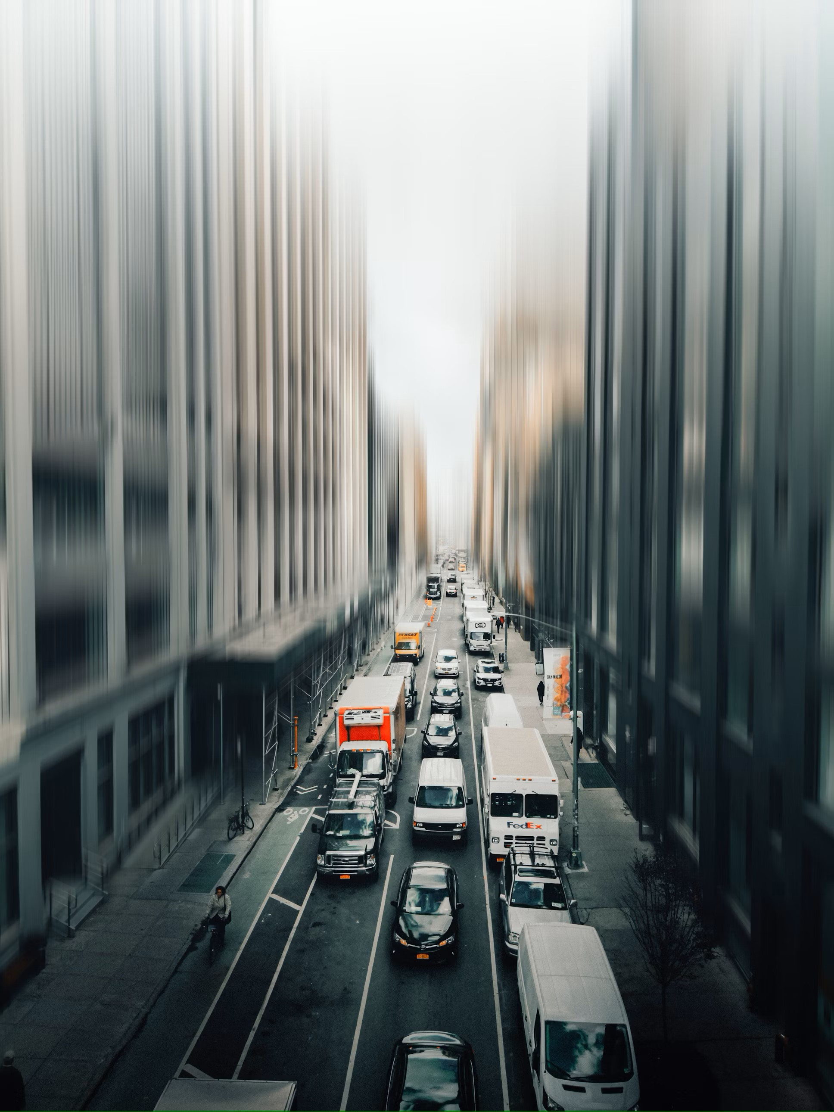
MODEL
A Decision Tree Regressor is a machine learning algorithm used for predicting continuous numerical values. It's a type of decision tree that splits data into subsets based on the features, using rules to partition the data in a way that minimizes prediction error.

Slide 6
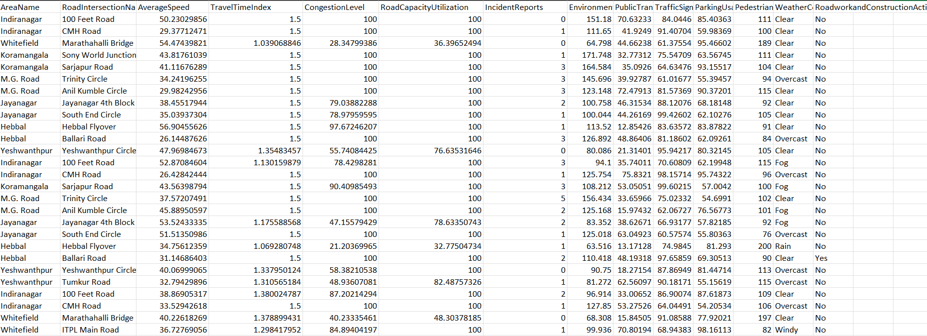
DATASET

Slide 7

APPLICATIONS
1:Enhance Public Transport: Expand, modernize, and make public transit reliable and affordable.
2:Promote Carpooling: Use carpool lanes, encourage ridesharing apps, and offer designated parking.
3:Support Active Transport: Build bike lanes, pedestrian paths, and implement bike-sharing programs.
4:Use Congestion Pricing: Charge fees for peak-hour driving to encourage alternatives.
5:Flexible Work Options: Encourage remote work and staggered hours to ease rush-hour pressure.
6:Smart Urban Planning: Create mixed-use neighborhoods to minimize long commutes.
7:Adopt Traffic Management Tech: Use intelligent signals and real-time updates to improve flow.
8:Promote Electric Vehicles: Offer incentives and infrastructure for EVs.
9:Support Mobility as a Service (MaaS): Combine various transport modes into one platform for seamless travel planning and payment.
10:Encourage Off-Peak Travel: Promote flexible schedules and policies to spread traffic across non-peak times.

Slide 8
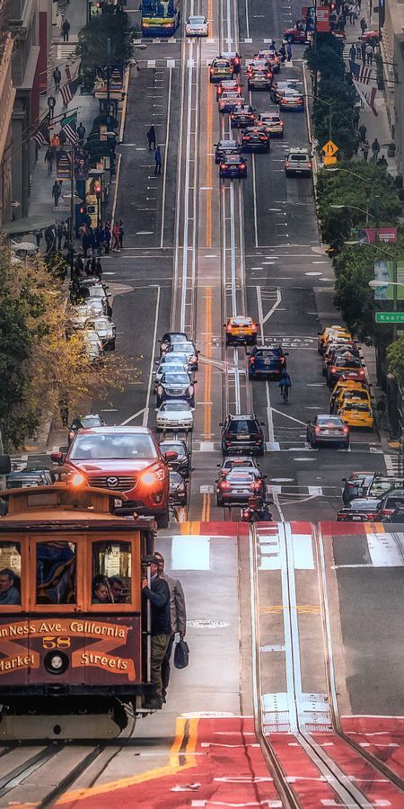
CONCLUSION
The dataset provides a valuable basis for analyzing and understanding traffic patterns in Bangalore, with implications for improving urban mobility and addressing congestion issues. Through careful examination of these factors, urban planners and policymakers can better understand the conditions contributing to traffic bottlenecks and make informed decisions to optimize city traffic flow and reduce environmental impact.

Slide 9
THANK YOU

